Slide 1

Basics of Web Design
Fifth Edition
Chapter 10
Form Basics Key Concepts
Copyright © 2019 Pearson Education, Inc. All Rights Reserved
Notes:
If this PowerPoint presentation contains mathematical equations, you may need to check that your computer has the following installed:
1) Math Type Plugin
2) Math Player (free versions available)
3) NVDA Reader (free versions available)

Slide 2
Learning Outcomes
Describe common uses of forms on web pages
Create forms on web pages using the form, input, textarea, and select elements
Associate form controls and groups using label, fieldset, and legend elements
Use C S S to style a form
Use Grid Layout to style a form
Describe the features and common uses of server-side processing
Invoke server-side processing to handle form data
Configure new HTML5 form controls and attributes

Slide 3
Overview of Forms
Forms are used all over the Web to
Accept information
Provide interactivity
Types of forms:
Search form, Order form, Newsletter sign-up form, Survey form, Add to Cart form, and so on…

Slide 4
Two Components of Using Forms
The web page form
An H T M L element that contains and organizes form controls such as text boxes, check boxes, and buttons that can accept information from website visitors.
and
The server-side processing
Server-side processing works with the form data and sends e-mail, writes to a text file, updates a database, or performs some other type of processing on the server.

Slide 5
H T M L Using Forms
<form> tag
Contains the form elements on a web page
Container tag
<input> tag
Configures a variety of form elements including text boxes, radio buttons, check boxes, and buttons
Stand alone tag
<textarea> tag
Configures a scrolling text box
Container tag
<select> tag
Configures a select box (drop down list)
Container tag
<option> tag
Configures an option in the select box
Container tag

Slide 6
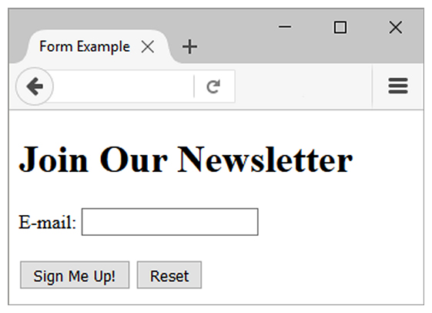
Sample Form H T M L
<form>
E-mail: <input type="text" name="email" id="email" >
<br><br>
<input type="submit" value="Sign Me Up!">
<input type="reset">
</form>

Slide 7
The Form Element <form>
Container Tag
The form element attributes:
action
Specifies the server-side program or script that will process your form data
method
get – default value, form data passed in U R L
post – more secure, form data passed in H T T P Entity Body
name
Identifies the form
id
Identifies the form

Slide 8
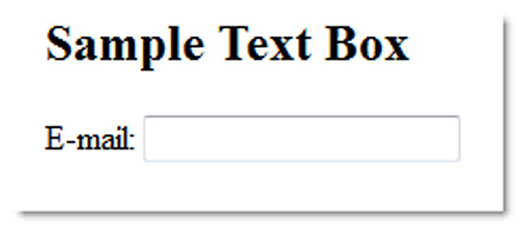
The Input Element Text Box <input>
Accepts text information
Common Attributes:
type="text"
name
id
size
maxlength
value
required (H T M L 5)
placeholder (H T M L 5)

Slide 9
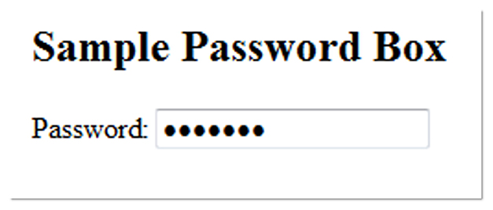
The Input Element Password Box <input>
Accepts text information that needs to be hidden as it is entered
Common Attributes:
type="password"
name
id
size
maxlength
value
required (H T M L 5)
placeholder (H T M L 5)

Slide 10
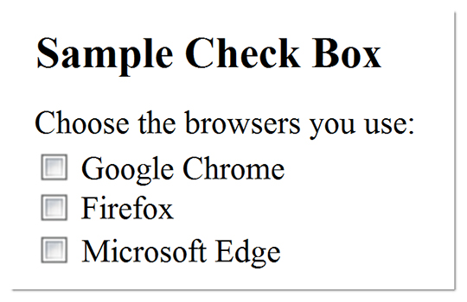
The Input Element Check box <input>
Allows the user to select one or more of a group of predetermined items
Common Attributes:
type="checkbox"
name
id
checked
value

Slide 11
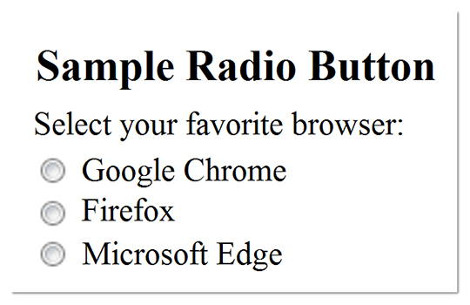
The Input Element Radio Button <input>
Allows the user to select exactly one from a group of predetermined items
Each radio button in a group is given the same name and a unique value
Common Attributes:
type="radio"
name
id
checked
value

Slide 12
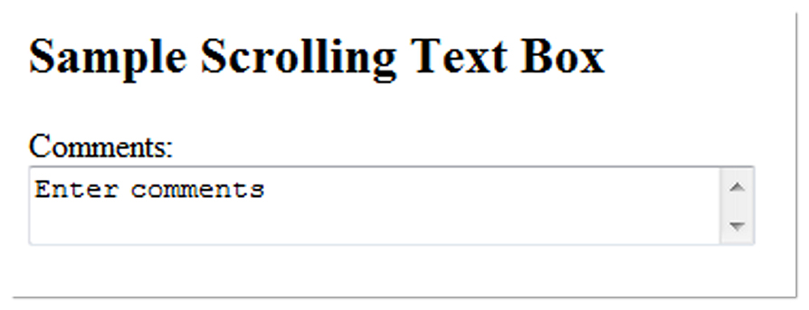
The Textarea Element <textarea>
Configures a scrolling text box
Common Attributes:
name
id
cols
rows

Slide 13

The Select Element <select>
Configures a select list (along with <option> tags)
Also known as: Select Box, Drop-Down List, Drop-Down Box, and Option Box.
Allows the user to select one or more items from a list of predetermined choices.
Common Attributes:
name
id
size
multiple

Slide 14
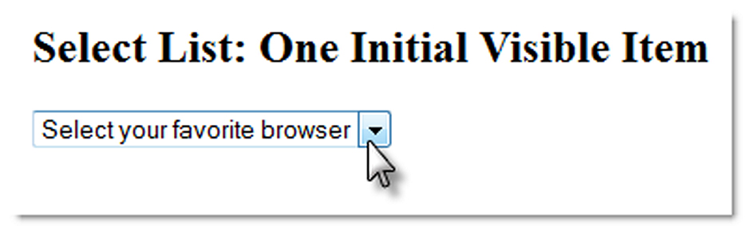
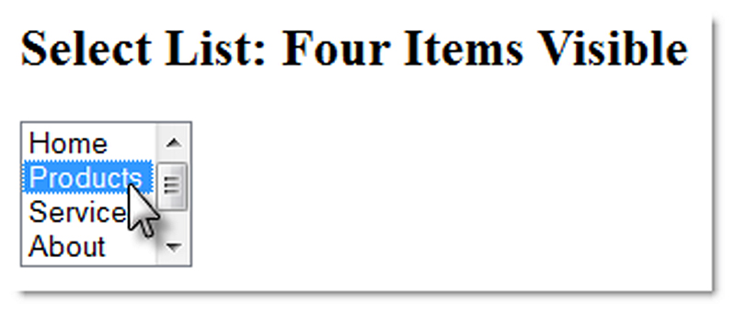
The Option Element <option>
Configures the options in a Select List
Attributes:
value
selected

Slide 15
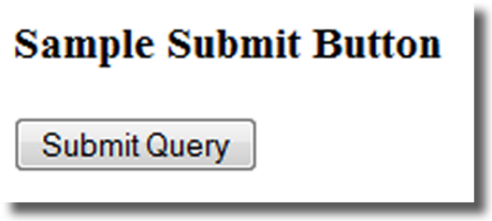
The Input Element Submit Button <input>
Submits the form information
When clicked:
Triggers the action method on the <form> tag
Sends the form data (the name=value pair for each form element) to the web server.
Attributes:
type="submit"
name
id
value

Slide 16
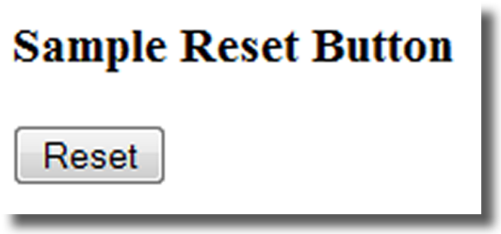
The Input Element Reset Button <input>
Resets the form fields to their initial values
Attributes:
type="reset"
name
id
value

Slide 17
The Input Element Hidden Field <input>
This form control is not displayed on the Web page.
Hidden form fields
Can be accessed by both client-side and server-side scripting
Common Attributes:
type="hidden"
name
id
value

Slide 18
The Label Element <label>
Associates a text label with a form control
Two Different Formats:
<label>Email: <input type="text" name="CustEmail" id ="CustEmail"></label>
OR
<label for="email">Email: </label> <input type="text" name="CustEmail" id= "email" />

Slide 19
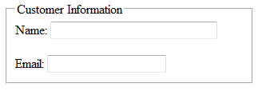
The Fieldset & Legend Elements
The Fieldset Element <fieldset>
Container tag
Creates a visual group of form controls on a web page
The Legend Element <legend>
Container tag
Creates a text label within the fieldset
<fieldset><legend>Customer Information</legend>
<label>Name: <input type="text" name="CName" id="CName" size="30"></label>
<br><br>
<label>Email: <input type="text" name="CEmail" id="CEmail"></label>
</fieldset>

Slide 20
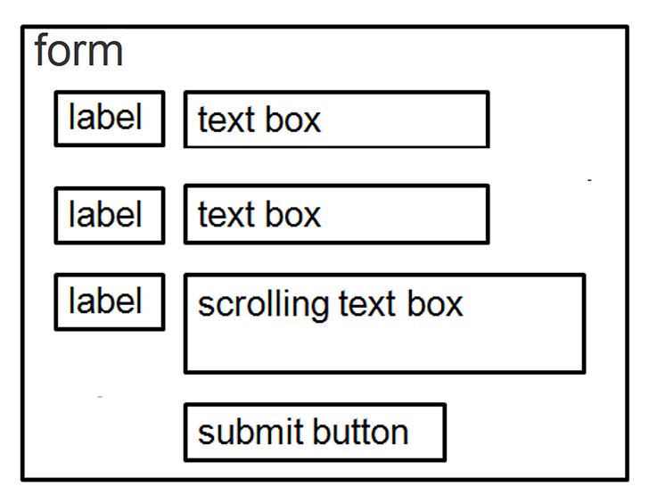
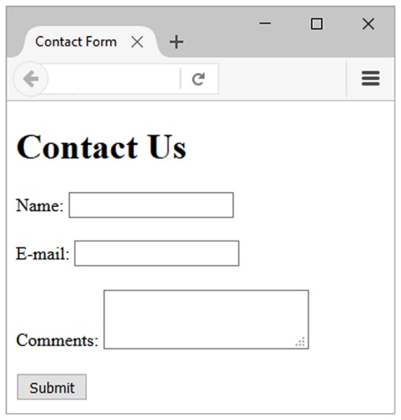
Using C S S to Style a Form
form { background-color:#e a e a e a; font-family: Arial, sans-serif;
width: 350px; padding: 10px;}
label { float: left; clear: left; display: block; width: 100px;
text-align: right; padding-right: 10px; margin-top: 10px; }
input, textarea { margin-top: 10px; display: block;}
input[type= "submit"]{ margin-left: 110px; }

Slide 21
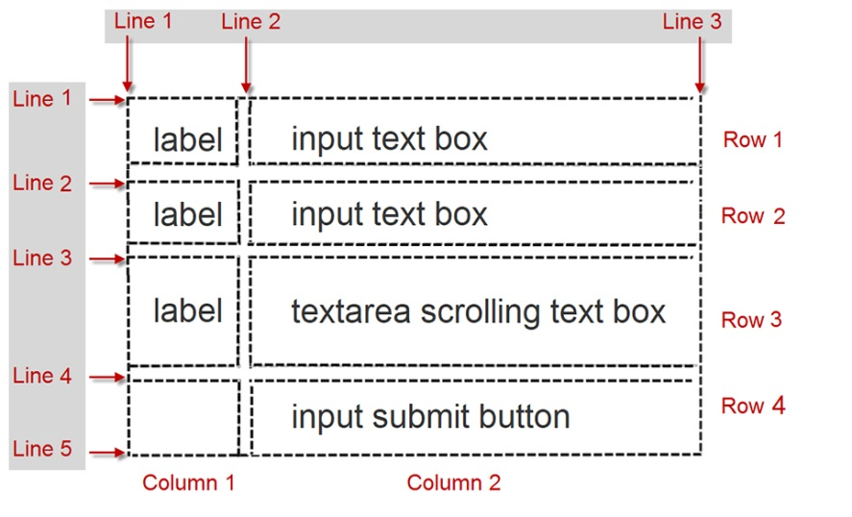

Using C S S Grid Layout to Style a Form
form { display: grid;
grid-template-rows: auto;
grid-template-columns: 6em 1fr;
grid-gap: 1em; gap: 1em;
background-color: #E A E A E A; font-family: Arial, sans-serif;
width: 60%; min-width: 20em; padding: 2em; }
input[type="submit"] { grid-column: 2 / 3;
width: 10em; }

Slide 22
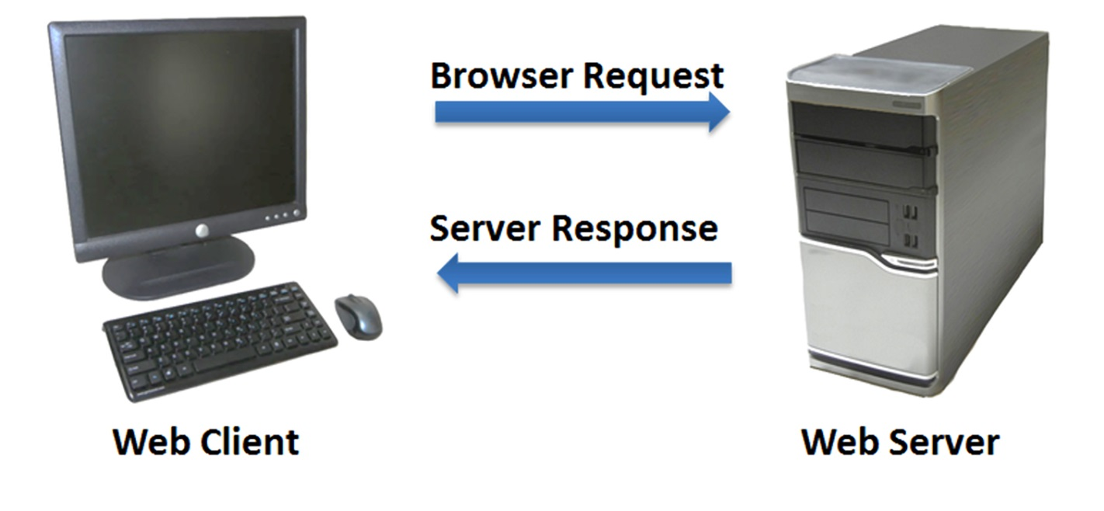
Server-Side Processing
Your web browser requests web pages and their related files from a web server.
The web server locates the files and sends them to your web browser.
The web browser then renders the returned files and displays the requested web pages for you to use.

Slide 23

Server-Side Scripting
One of many technologies in which a server-side script is embedded within a web page document saved with a file extension such as:
.php (P H P)
.cfm (Adobe ColdFusion)
.jsp (Sun JavaServer Pages)
.aspx (A S P.Net)
Uses direct execution — the script is run either by the web server itself or by an extension module to the web server.

Slide 24
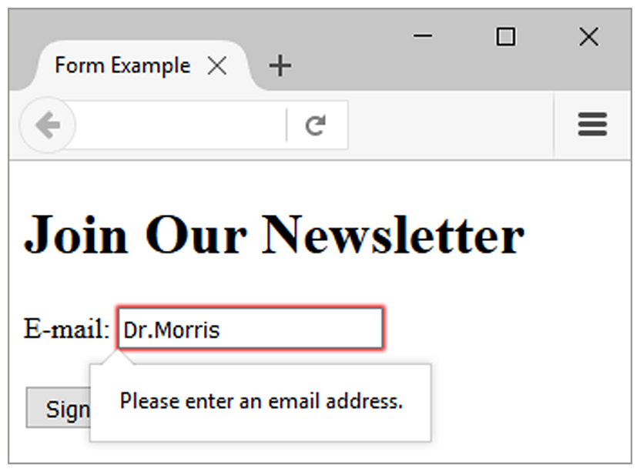
H T M L 5: Email Text Box <input>
Accepts text information in e-mail address format
Common Attributes:
type="email"
name
id
size
maxlength
value
placeholder
required

Slide 25
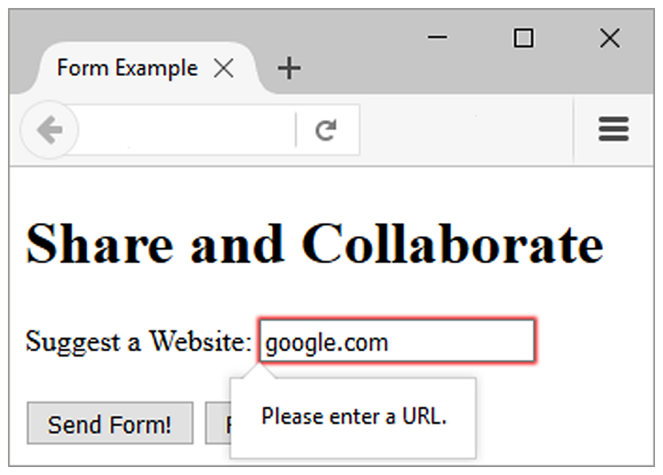
H T M L 5: U R L Text Box <input>
Accepts text information in U R L format
Common Attributes:
type="url"
name
id
size
maxlength
value
placeholder
required

Slide 26
H T M L 5: Telephone Number Text Box <input>
Accepts text information in telephone number format
Common Attributes:
type="tel"
name
id
size
maxlength
value
placeholder
required

Slide 27
H T M L 5: Search Text Box <input>
Accepts search terms
Common Attributes:
type="search"
name
id
size
maxlength
value
placeholder
required

Slide 28
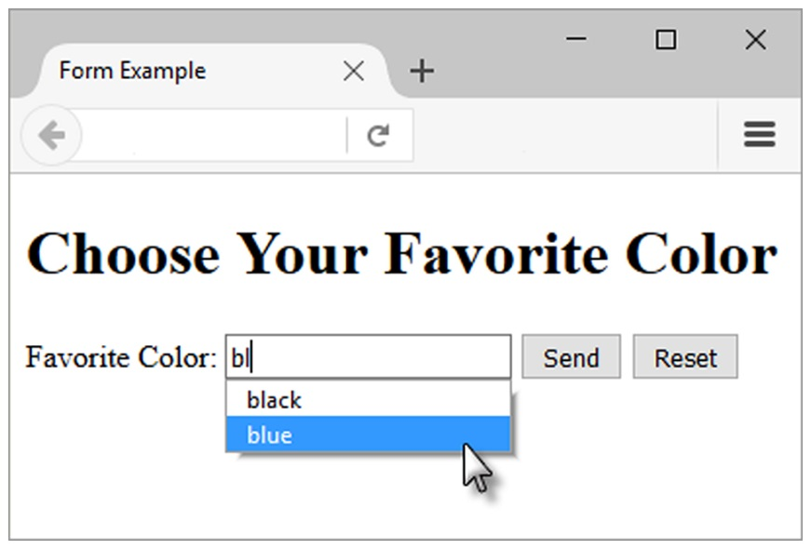
H T M L 5: Datalist Control
<label for="color">Favorite Color:</label> <input type="text" name="color" id="color" list="colors" >
<datalist id="colors">
<option>red</option>
<option>green</option>
<option>blue</option>
<option>yellow</option>
<option>pink</option>
<option>black</option>
</datalist>

Slide 29
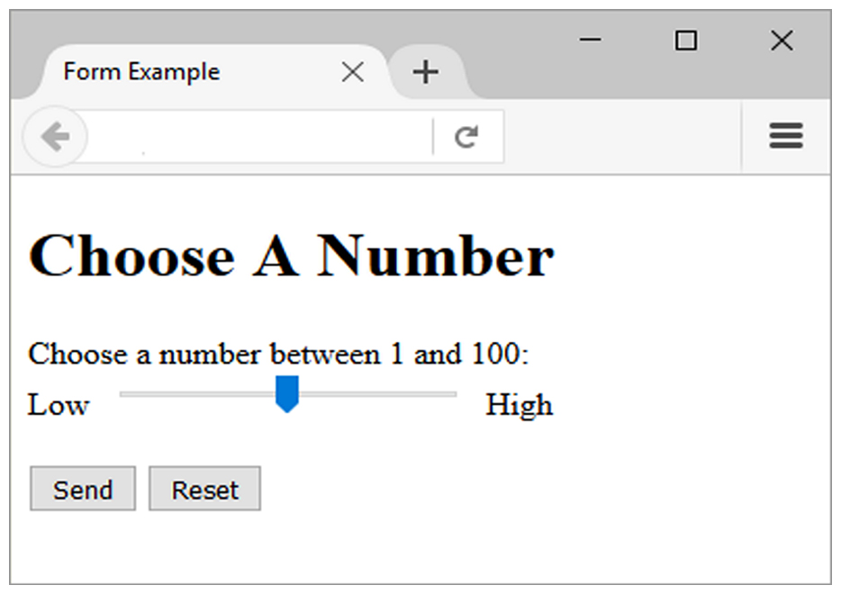
H T M L 5: Slider Control <input>
<label for="myChoice">
Choose a number between 1 and 100:</label><br>
Low <input type="range" name="myChoice" id="myChoice"> High

Slide 30
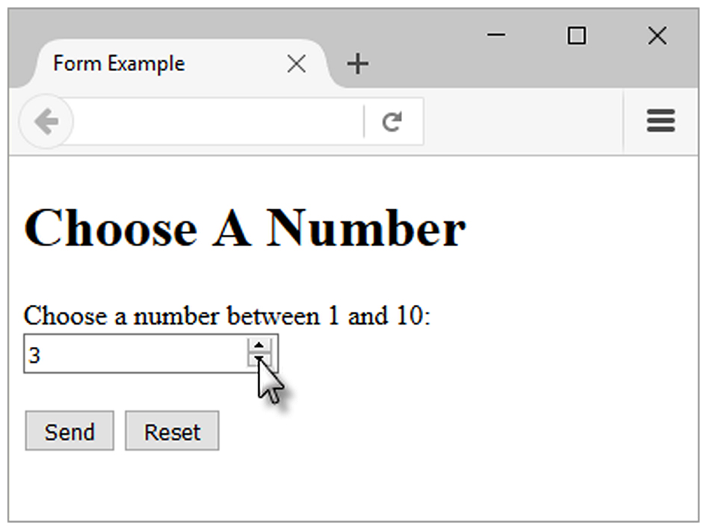
H T M L 5: Spinner Control <input>
<label for="myChoice"> Choose a number between 1 and 10:</label> <input type="number" name="myChoice" id="myChoice“ min="1" max="10">

Slide 31
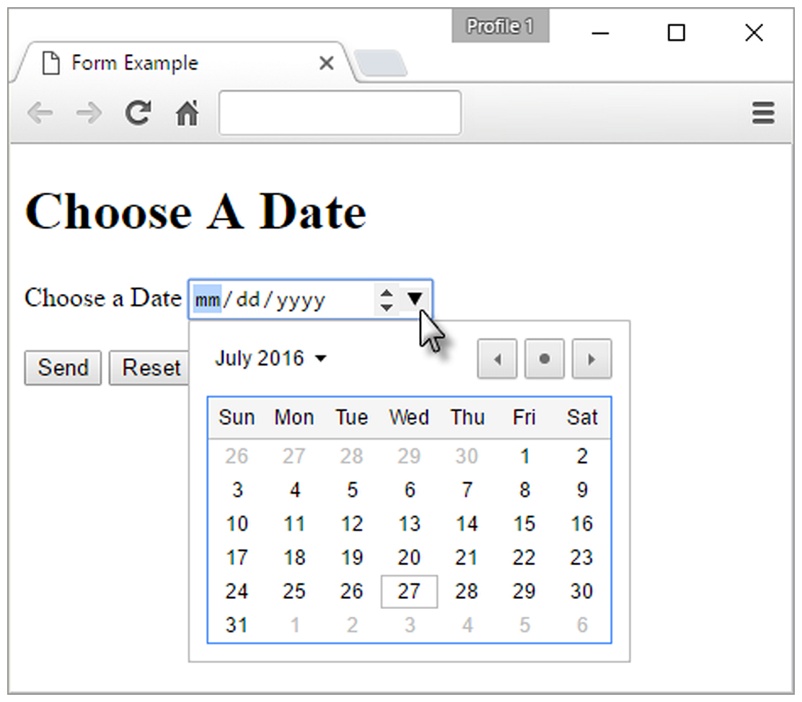
H T M L 5: Calendar Control <input>
<label for="myDate">Choose a Date</label> <input type="date" name="myDate" id="myDate">

Slide 32
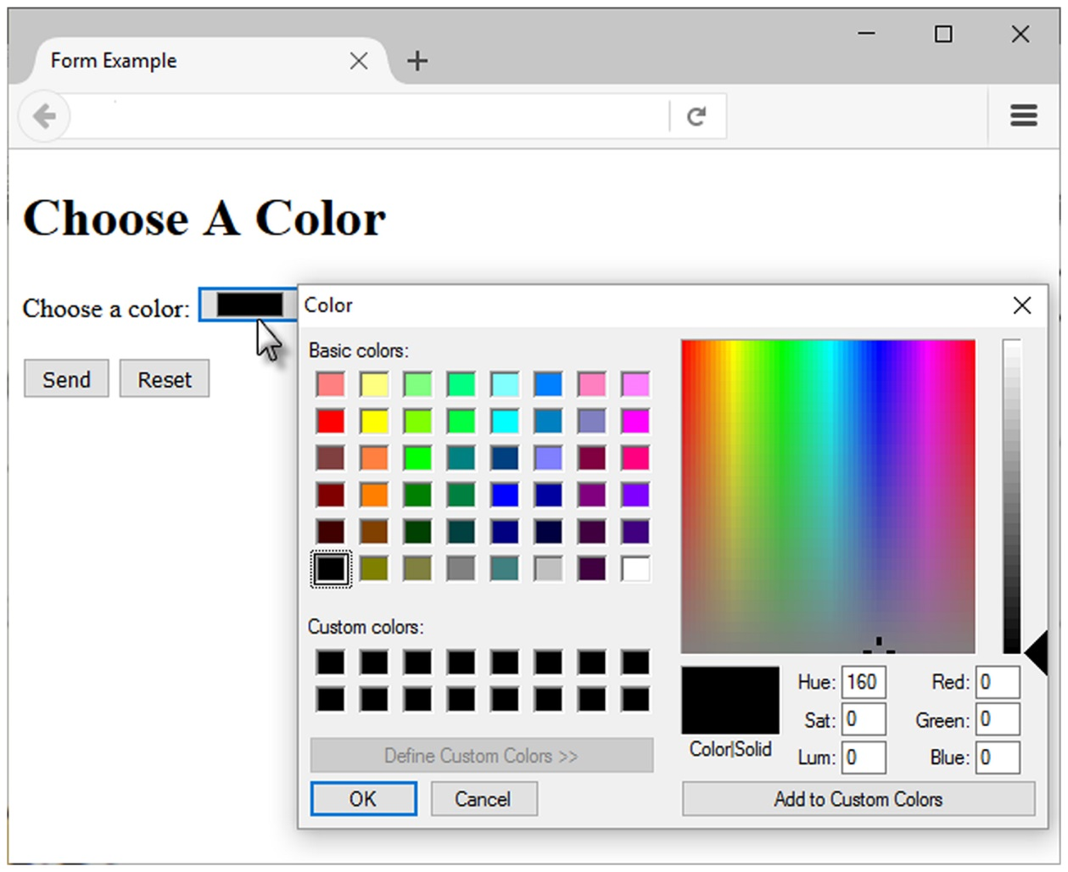
H T M L 5 Color-well Control
<label for="myColor">Choose a color:</label>
<input type="color" name="myColor" id="myColor">

Slide 33
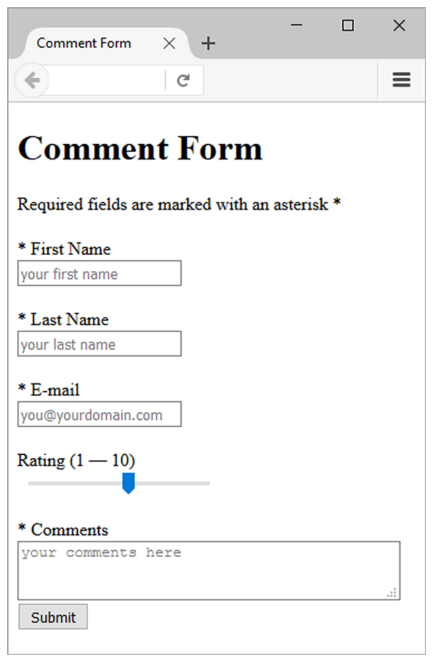
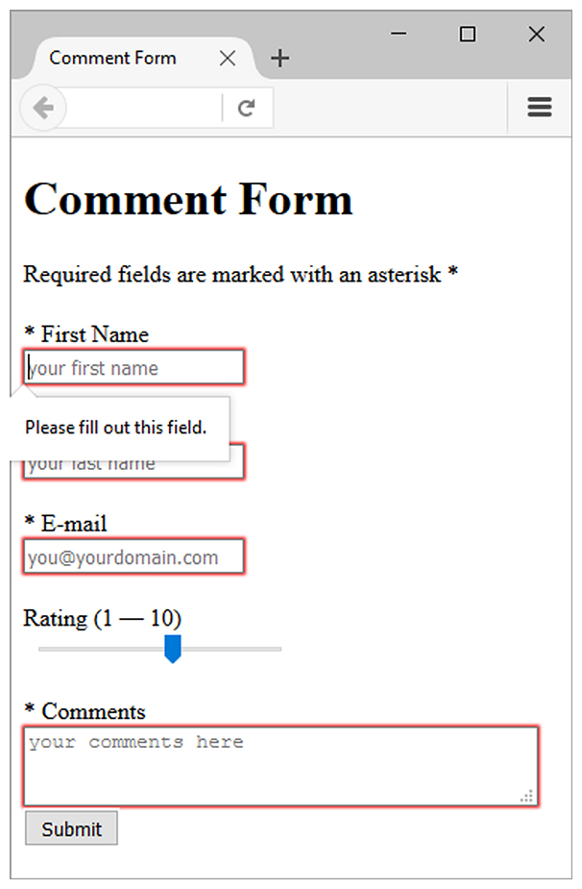
Practice with an H T M L 5 Form
The form display and functioning varies with browser support.

Slide 34
Summary
This chapter introduced the use of forms on web pages.
You learned about how to configure form elements and provide for accessibility.
You learned how to configure a form to access server-side processing.
You also learned about new H T M L 5 form controls and attributes.

Slide 35

Copyright
This work is protected by United States copyright laws and is provided solely for the use of instructors in teaching their courses and assessing student learning. Dissemination or sale of any part of this work (including on the World Wide Web) will destroy the integrity of the work and is not permitted. The work and materials from it should never be made available to students except by instructors using the accompanying text in their classes. All recipients of this work are expected to abide by these restrictions and to honor the intended pedagogical purposes and the needs of other instructors who rely on these materials.

